Slide 1
Spondyloarthropathies Dr. Husham Aldaoseri 12.Oct.2023

Slide 2
Objectives
Become familiar with joints,spine and extra-spinal manifestations of SpA
1
2
3
Gain a basic understanding of the Spondylo-Arthritis
Learn specific Characteristics SpA
Differentiate SpA from other chronic Arthritis
Understand the current treatment paradigm and medications used

Slide 3
Introduction
Spondyloarthropathies SPA
Seronegative Spondyloarthritis
Absence of Rheumatoid Factor or other autoantibody serologic abnormalities:
Ankylosing Spondylitis-AS (Prototype)
Psoriatic Arthritis-PsA
Reactive Arthritis-ReA
Enteropathic Arthritis-IBD
Undifferentiated Spondyloarthropathy-SpA

Slide 4
Arthritis
Associated with
Inflammatory
Bowel
Juvenile
Spondyloarthritis
Ankylosing
Spondylitis
Psoriatic
Arthritis
Undifferentiated
Spondyloarthritis
Acute
Anterior
Uveitis
Reactive
arthritis

Slide 5
Spondyloarthropaties
The pathology of spondyloarthropathies is very different from that of RA. In RA, it is the synovitis that plays the major role, and the synovitis leads to bony erosions that don't heal.
In spondyloarthritis there is some synovitis, but it's the enthesitis that is the major problem, especially in the axial disease.

Slide 6
Spondyloarthropaties
Not only is there enthesitis but also the osteitis that follows, which is different because there is reactive bone sclerosis and bone absorption, but then more bone remodeling sets in and it goes on to result in new bone formation that can result in ankylosis

Slide 7
Spondyloarthropaties
In RA, the cytokines lead to excessive osteoclastic activity resulting in bone erosions.
In spondyloarthritis, the cytokines that are playing a major role result in osteoblastic activity
Gradual bony bridging follows after being initiated by the inflammation

Slide 8
ANKYLOSING SPONDYLITIS
MARIE-STRUMPELL DISEASE
(BECHTEREW DISEASE))

Slide 9
QUES.
A 32-year-old man presents with several months of lower back pain that is worse at night. He loosens up after he wakes up and walks around for a while. Physical examination shows diminished expansion of the chest on inhalation and flattening of the normal lumbar curvature. He is unable to lean forward. He had an episode of uveitis treated with steroids 5 months earlier.
What is the most likely diagnosis?
What is the best initial test?
What is the most accurate test?
What is the best initial treatment?
What is the most effective treatment?

Slide 10
Inflammatory disorder of unknown cause that primarily affects the axial skeleton; peripheral joints and extra-spinal structures.
Rheumatoid factor absent
HLA-B27 present in > 90% cases
Disease usually begins in the second or third decade.
M:F= 3:1

Slide 11
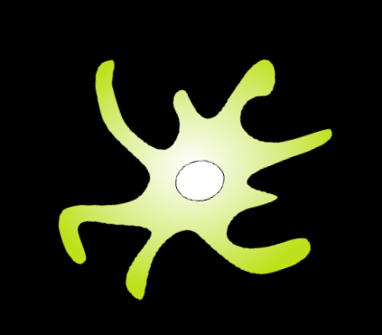
HLA B27 misfolding and the unfolded protein respons (UPR) increase IL23 production
UPR
+
Th1
IFNγ
IL 23
IL12/STAT4
IL-6/TGFβ
IL17
TNF
IL6
Th0
+
Th17
IL4/STAT6
TGFβ/IL10
Th2
IL4, IL10
TReg
DeLay M et al. Arthritis Rheum 2009,;60: 2633–2643.

Slide 13
Inflammatory back pain
Onset before age 40
Insidious onset
Persistence for at least 3 months
Associated with morning stiffness
Improvement with exercise

Slide 14
Comparison of inflammatory and mechanical back pain
IBP
MBP
Age at onset <40 years
Age at onset; any age
Insidious onset; less likely to be acute
Variable onset; may be acute
Pain improves with exercise
Pain may worsen with movement
Pain does not improve with rest
Pain at night that may wake patient during second half of the night
Pain often improves with rest
Morning stiffness >30 minutes

Slide 15
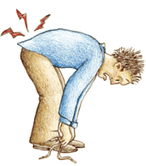
SYMPTOMS AND SIGNS
The typical presenting symptom in ankylosing spondylitis is the insidious onset of inflammatory low back pain due to sacroiliitis.
The pain is dull and located in the lower lumbar regions.
Some describe a deep alternating buttock pain.

Slide 16
The pain worsens with rest, improves with activity, and is accompanied by morning stiffness that lasts 30 minutes or longer.
Patients often describe awakening from sleep and pacing in order to relieve nocturnal pain—a rare complaint in patients with mechanical back pain.

Slide 17
Involvement of the spine (spondylitis) is the major source of morbidity.
Ankylosing spondylitis can involve the lumbar, thoracic, and cervical spine.
Over time the accumulation of pathologic changes can lead to loss of spinal mobility, particularly of the lumbar spine.

Slide 18
Involvement of the costovertebral and costochondral joints commonly leads to impaired chest expansion (<2.5 cm difference between full inspiration and full expiration when measured at the fourth intercostal space)
Occasionally this produces pain with deep breathing, coughing, or sneezing

Slide 19
Peripheral Joint Manifestations
Monarticular or asymmetric oligoarticular.
Develops in approximately one-third of patients.
Most often affects large joints of the lower extremities.
Hip disease develops in approximately 50% of patients and is a major source of morbidity.

Slide 20
Enthesitis
Involvement of insertion sites around the pelvis (the ischial tuberosities, iliac crests, and greater trochanters) . Achilles tendinitis and enthesitis at the site of the insertion of the plantar fascia onto the calcaneus can cause unilateral or bilateral heel pain.

Slide 21
Ocular
The most common extra-articular manifestation of ankylosing spondylitis is acute anterior uveitis.
It is heralded by the acute or subacute onset of unilateral eye pain, photophobia, blurred vision, and increased lacrimation.
Anterior uveitis can precede the onset of ankylosing spondylitis by several years.
Anterior uveitis is strongly associated with HLA-B27.

Slide 22
Other Organs
Ascending aortitis, aortic regurgitation, conduction abnormalities, and myocardial disease--- 1% of patients with ankylosing spondylitis.
Secondary amyloidosis.
Retroperitoneal fibrosis.
Apical pulmonary fibrosis disease radiographically resembles reactivation of tuberculosis

Slide 23
Cervical mobility
Test
TEST and MEASUREMENT for AS
Thoracic mobility
Lumber mobility
Occiput-to-wall distance
Tragus-to-wall distance
Cervical rotation
Chest expansion
Modified schober Test
Finger-to-floor distance
Lumber lateral flexion

Slide 24
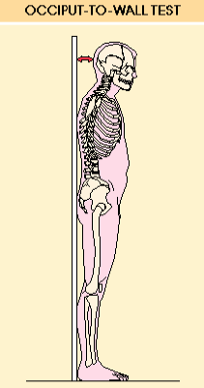
Occiput To Wall Distance
The severity of cervical flexion deformity in ankylosing spondylitis can be assessed by measuring the occiput to wall distance
With the patient standing erect, the heels and the buttocks are placed against a wall; the patient is then instructed to extend his or her neck maximally in an attempt to touch the wall with the occiput.
The distance between the occiput and the wall is a measure of the degree of flexion deformity of the cervical spine.
The occiput to wall distance should be zero

Slide 25
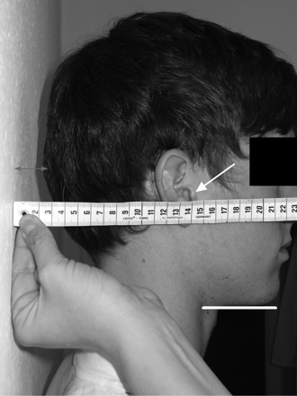
Tragus-to-wall distance
Measure distance between tragus of the ear and wall on both sides.

Slide 26
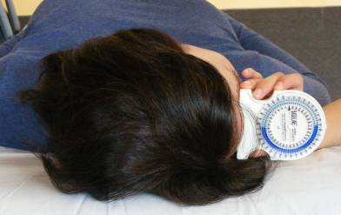
Cervical rotation
Patient supine, head in neutral position, forehead horizontal (if necessary head on pillow or foam block to allow this, must be documented for future reassessments).
Normal ROM: 70-90⁰

Slide 27
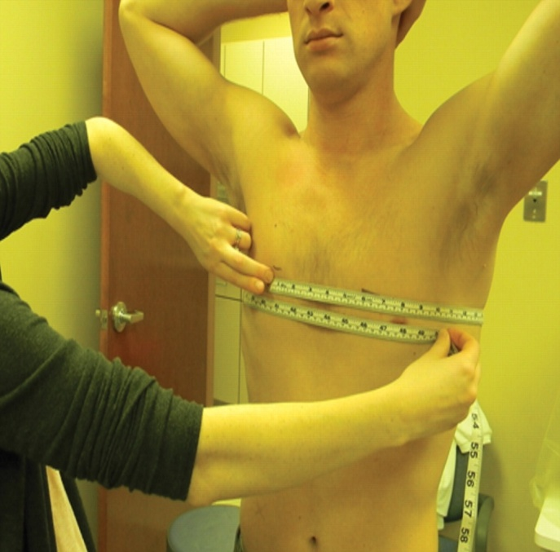
Chest expansion
Measured as the difference between maximal inspiration and maximal forced expiration in the fourth intercostal space in males or just below the breasts in females. Normal chest expansion is ≥ 2.5 cm.

Slide 28
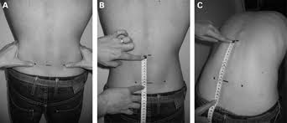
Lumbar flexion (modified Schober)
With the patient standing upright, place a mark at the lumbosacral junction (at the level of the dimples of Venus on both sides). Further marks are placed 5 cm below and 10 cm above. Measure the distraction of these two marks when the patient bends forward as far as possible, keeping the knees straight
The distance less than 5 cm is abnormal

Slide 29
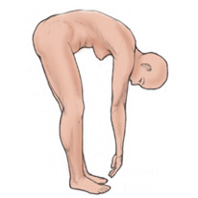
Finger to floor distance
Expression of spinal column mobility when bending over forward; the dimension that is measured is the distance between the tips of the fingers and the floor when the patient is bent over forward with knees and arms fully extended.

Slide 30
Lateral spinal flexion
Patient standing with heels and buttocks touching the wall, knees straight.
.
>>>>
>>>>

Slide 31
TESTS FOR SACROILITIS
Pelvic compression test
Faber test
Gaenslen Test

Slide 32
GAENSLEN TEST
Gaenslen test stresses the sacroiliac joints,
Increased pain during this test could be indicative of joint disease.

Slide 33
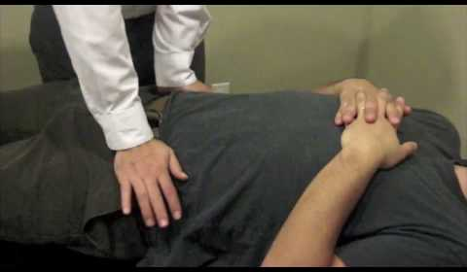
PELVIC COMPRESSION TEST
Test irritability by compressing the pelvis with the patient prone.

Slide 34
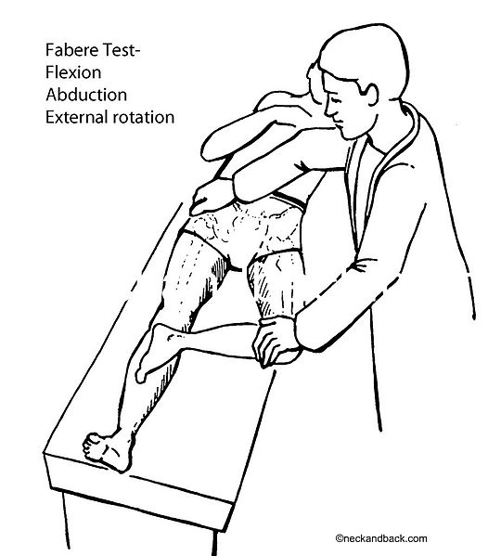
Patrick's test or FABER test
The test is performed by having the tested leg flexed, abducted and externally rotated. If pain results, this is considered a positive Patrick's test.

Slide 35
Examination findings in patients with mechanical back pain
Positive straight leg raise test
Specific tenderness around the lumbar spine
Observe for scoliosis
Absent reflexes
Restricted range of movement
Neurological examination

Slide 36
LABORATORY FINDINGS
Mild, normocytic, normochromic anemia, reflective of chronic disease.
About half of patients with active disease will have elevations of the erythrocyte sedimentation rate or C-reactive protein.
Negative RF, ACCP and ANA

Slide 37
IMAGING STUDIES
Sacroiliac Joints
The most distinctive finding is inflammation of both sacroiliac joints.
A standard antero-posterior radiograph of the pelvis is commonly used to evaluate these S-shaped joints.

Slide 38
The radiographic finding is the appearance of iliac erosions.
With time erosions become more prominent and produce "pseudowidening" of the sacroiliac joint.
Progressive inflammation leads to fusion, and the end result can be complete obliteration of the sacroiliac joint by bone and fibrous tissue.

Slide 42
MRI

Slide 43
Spine
Romanus lesions : Radiographic appearance of vertebral "shiny corners.“
These are a reaction to inflammation at the site where the annulus fibrosus of the disks inserts onto the vertebral bodies.
With progressive erosions and formation of new periosteal bone, the lumbar vertebral bodies become "squared off" in the lateral view.

Slide 44
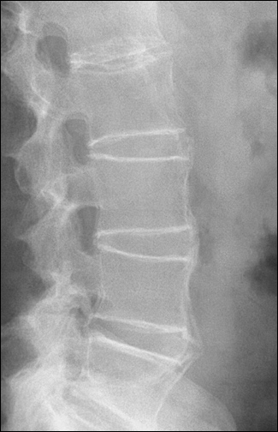
Lumbar spine: bridging syndesmophytes, “bamboo spine”.
New bone forms along the interosseous ligaments.
Notes:
Lumbar spine: bridging syndesmophytes, “bamboo spine”.
New bone forms along the interosseous ligaments.

Slide 45
Ankylosing spondylitis: lumbar vertebrae, bamboo spine (radiograph)

Slide 46
MRI

Slide 48
TREATMENT
GOALS OF THERAPY :
• Symptomatic relief — To reduce the symptoms such as pain and stiffness.
Restore function — To return the patient to the best possible functional capacity.
Prevent joint damage
Prevent spinal fusion & complications
Minimize extraspinal and extraarticular manifestations
.

Slide 49
PHYSICAL THERAPY AND EXERCISE
 Thin or no pillow
 Physical therapy to maintain posture and prevent progressive thoracic kyphosis and loss of mobility
 Breathing exercises to maintain chest wall expansion

Slide 51
PHARMACOLOGIC THERAPY
Nonsteroidal antiinflammatory drugs
Unless contraindicated, NSAIDs should be the first line of treatment for all symptomatic AS patients.
Sulfasalazine
Prior to the discovery of anti-TNF therapies in AS, the only disease-modifying agent that had been demonstrated to be useful in AS.

Slide 52
Glucocorticoids
systemic glucocorticoids on a long-term basis for patients with AS is not recommended.
Injection of a long-acting corticosteroid into the sacroiliac joints may be beneficial in patients with marked pain at the sacroiliac joints

Slide 53
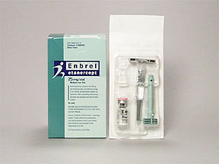
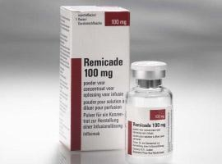
Anti-TNF-α therapy
Etanercept, Infliximab, Adalimumab
Approximately 80 percent of patients with AS respond to treatment with one of these agents.
Improvement noted in:
Patient assessment of pain
A functional assessment
Degree of inflammation as assessed by morning stiffness

Slide 54
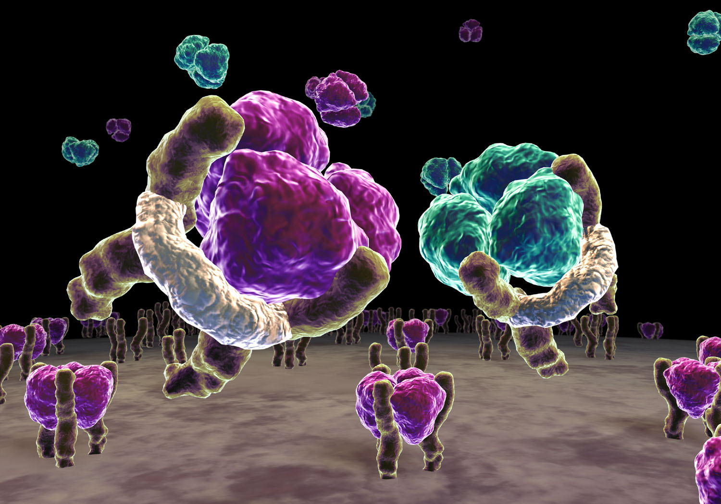
Etanercept – mode of action
Link and neutralization of soluble TNF-α; link also with TNF-β (lymfotoxin)
Etanercept (soluble TNF-receptor)
Soluble TNF-α
TNF-β (lymfotoxin)
TNF-α linked with receptor
Notes:
One approach to TNF inhibition has been the development of artificial constructs created by fusing 2 recombinant soluble TNF receptor molecules with the Fc portion of human immunoglobulin. This slide shows in three dimensions the combination of soluble TNF receptor fusion proteins with soluble TNF. These constructs bind soluble TNF-α and TNF-β, but do not bind and neutralize membrane-bound TNF-α.¹
Enbrel [prescribing information]. Seattle, WA: Immunex Corporation; 2002.

Slide 55
QUES.
A 32-year-old man presents with several months of lower back pain that is worse at night. He loosens up after he wakes up and walks around for a while. Physical examination shows diminished expansion of the chest on inhalation and flattening of the normal lumbar curvature. He is unable to lean forward. He had an episode of uveitis treated with steroids 5 months earlier.
What is the most likely diagnosis?
What is the best initial test?
What is the most accurate test?
What is the best initial treatment?
What is the most effective treatment?

